Slide 1
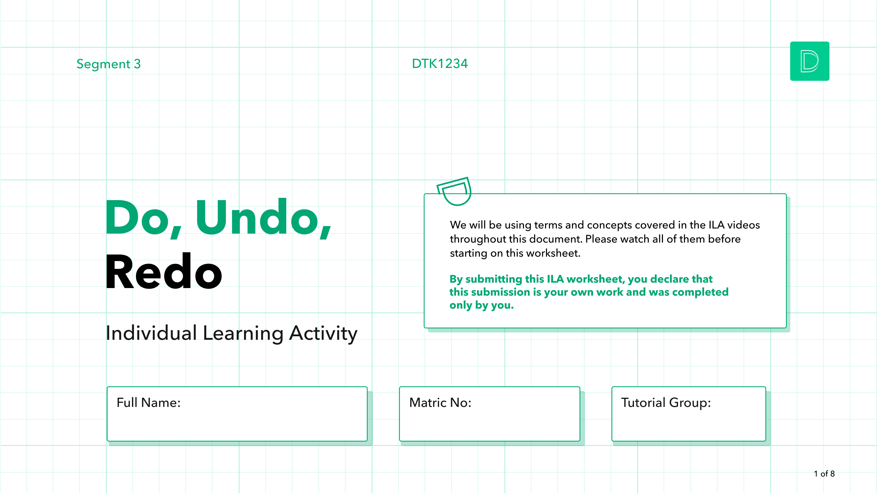
[Type here]
[Type here]
[Type here]
Notes:
Resources for prototyping methods: https://tinyurl.com/dtkprototyping

Slide 2
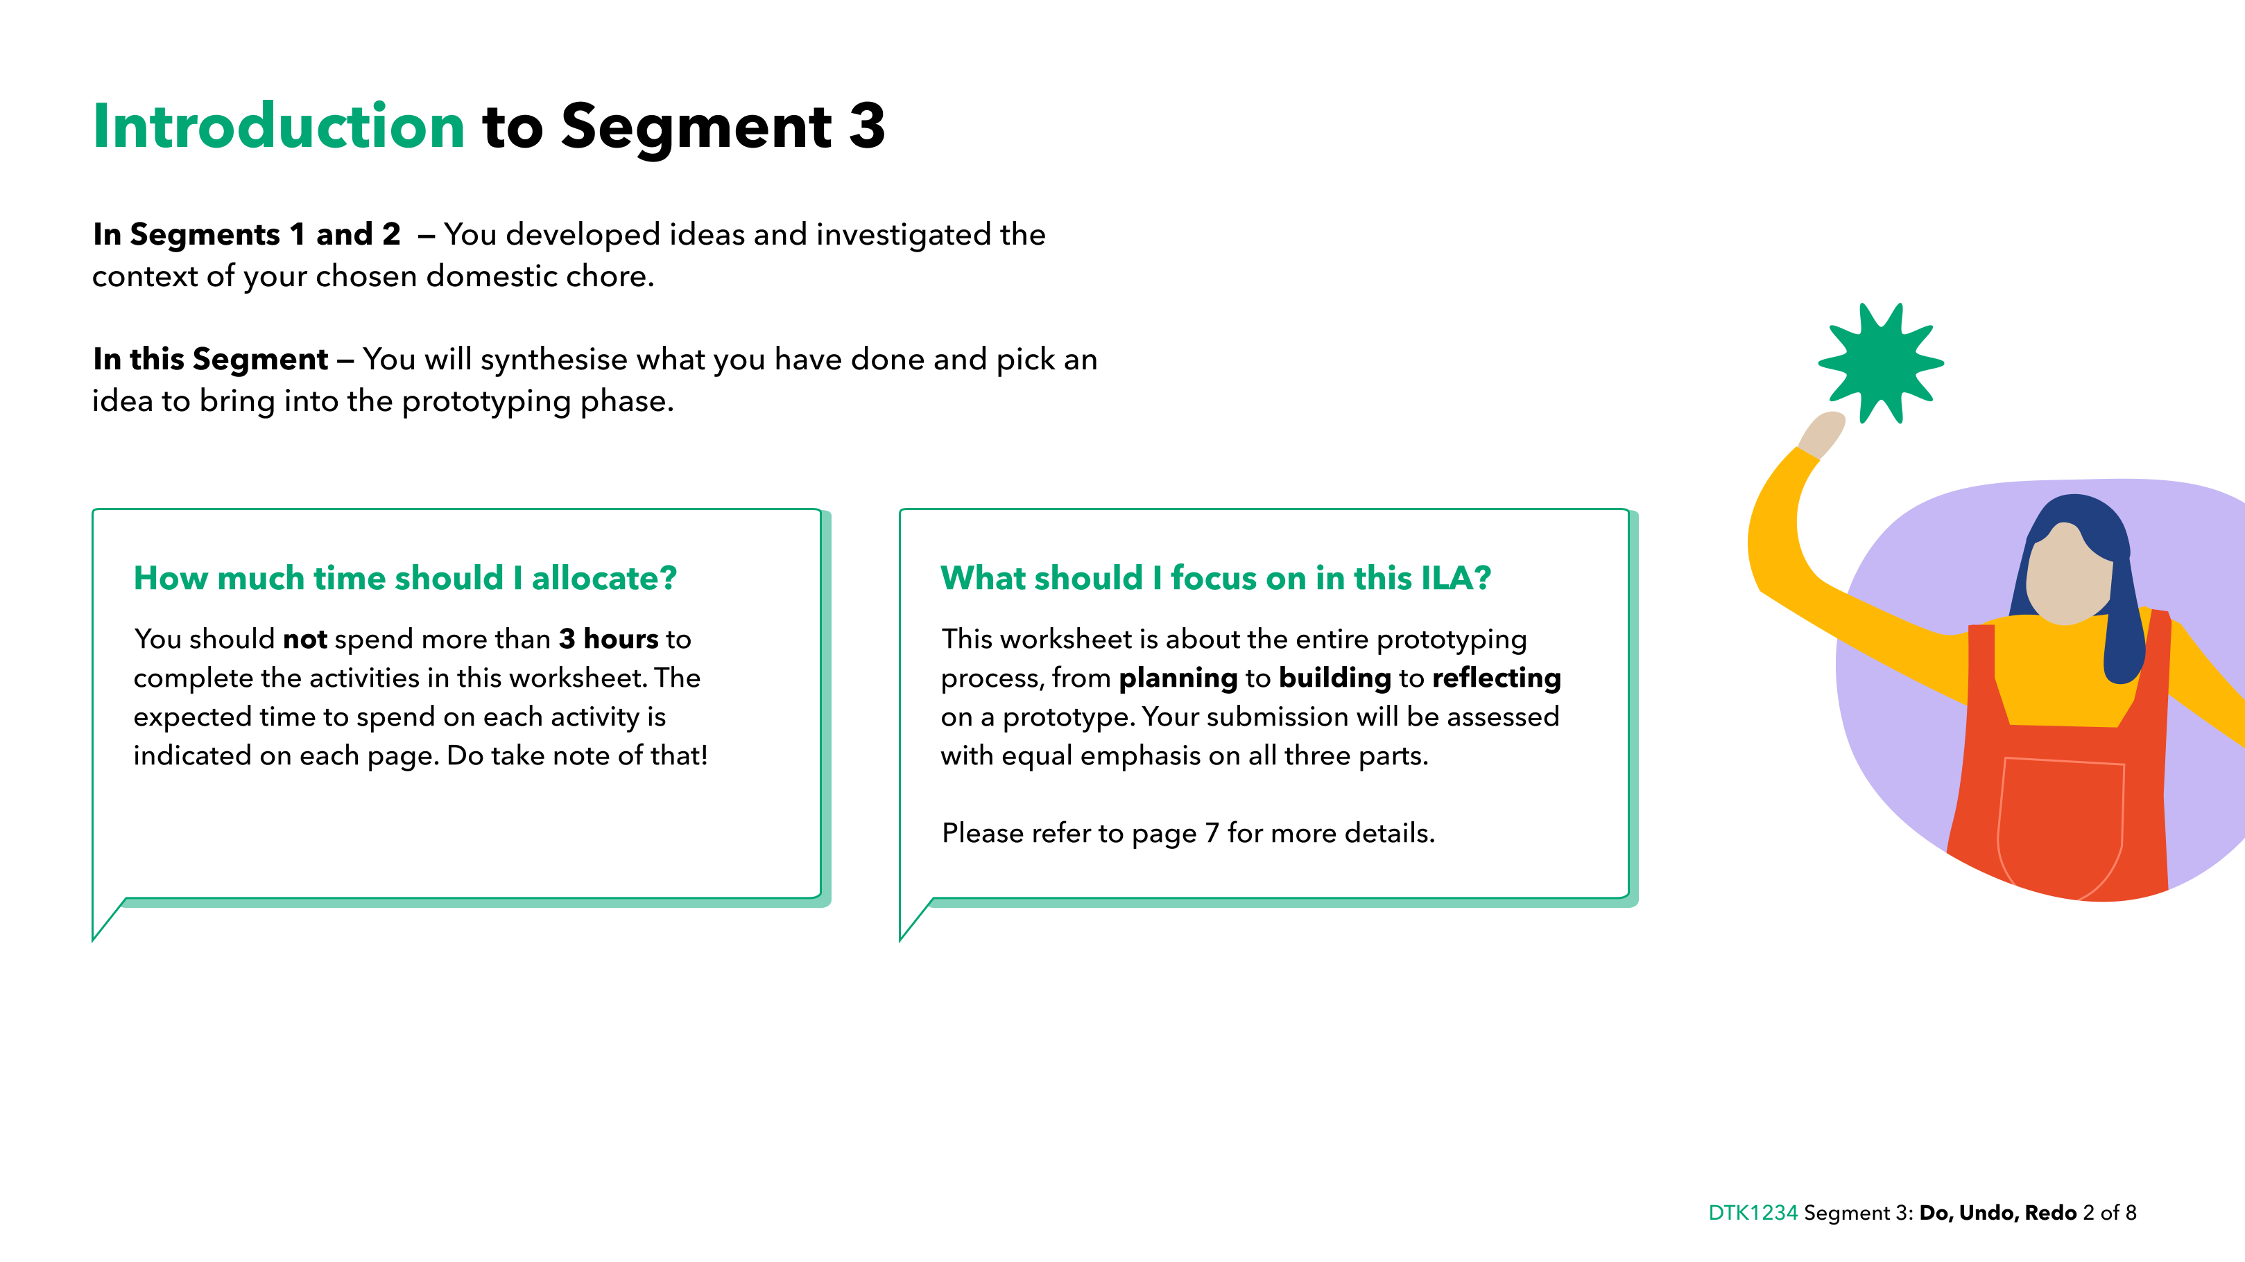

Slide 3
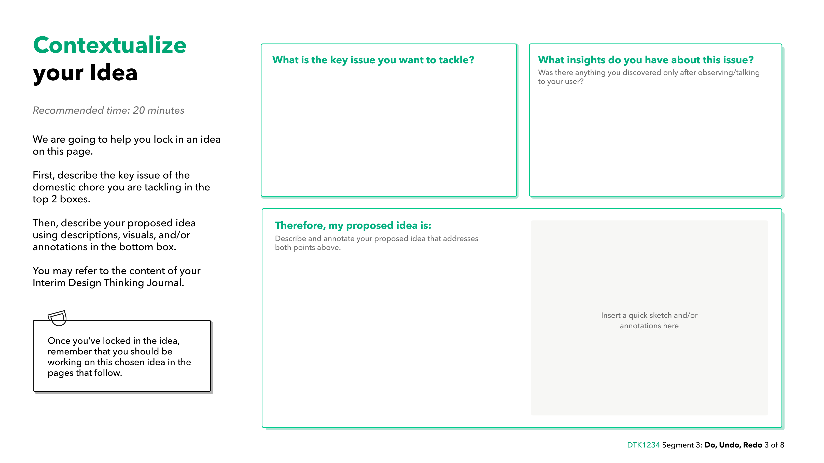
[Type here]
[Type here]
[Type here]

Slide 4
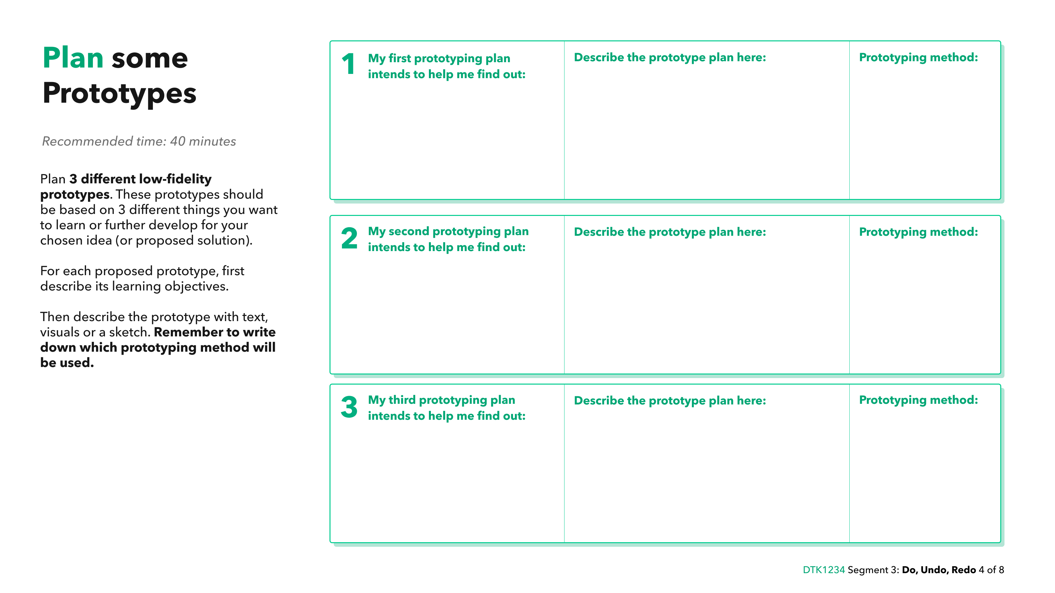
[How do you plan to prototype it?
What materials would you need, etc.]
[eg. Cardboard Prototyping, Paper Prototyping, Simulation, Wizard of Oz, etc.]
[What do you want to learn & why]

Slide 5
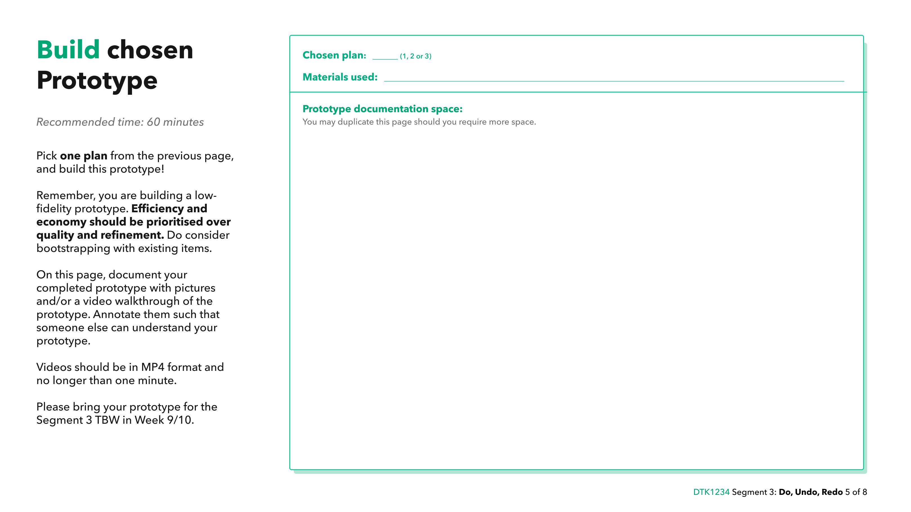
[1/2/3]
[Type here]
Notes:
For videos, try to keep the file size small by using an online video compression tool like https://veed.io./video-compressor

Slide 6
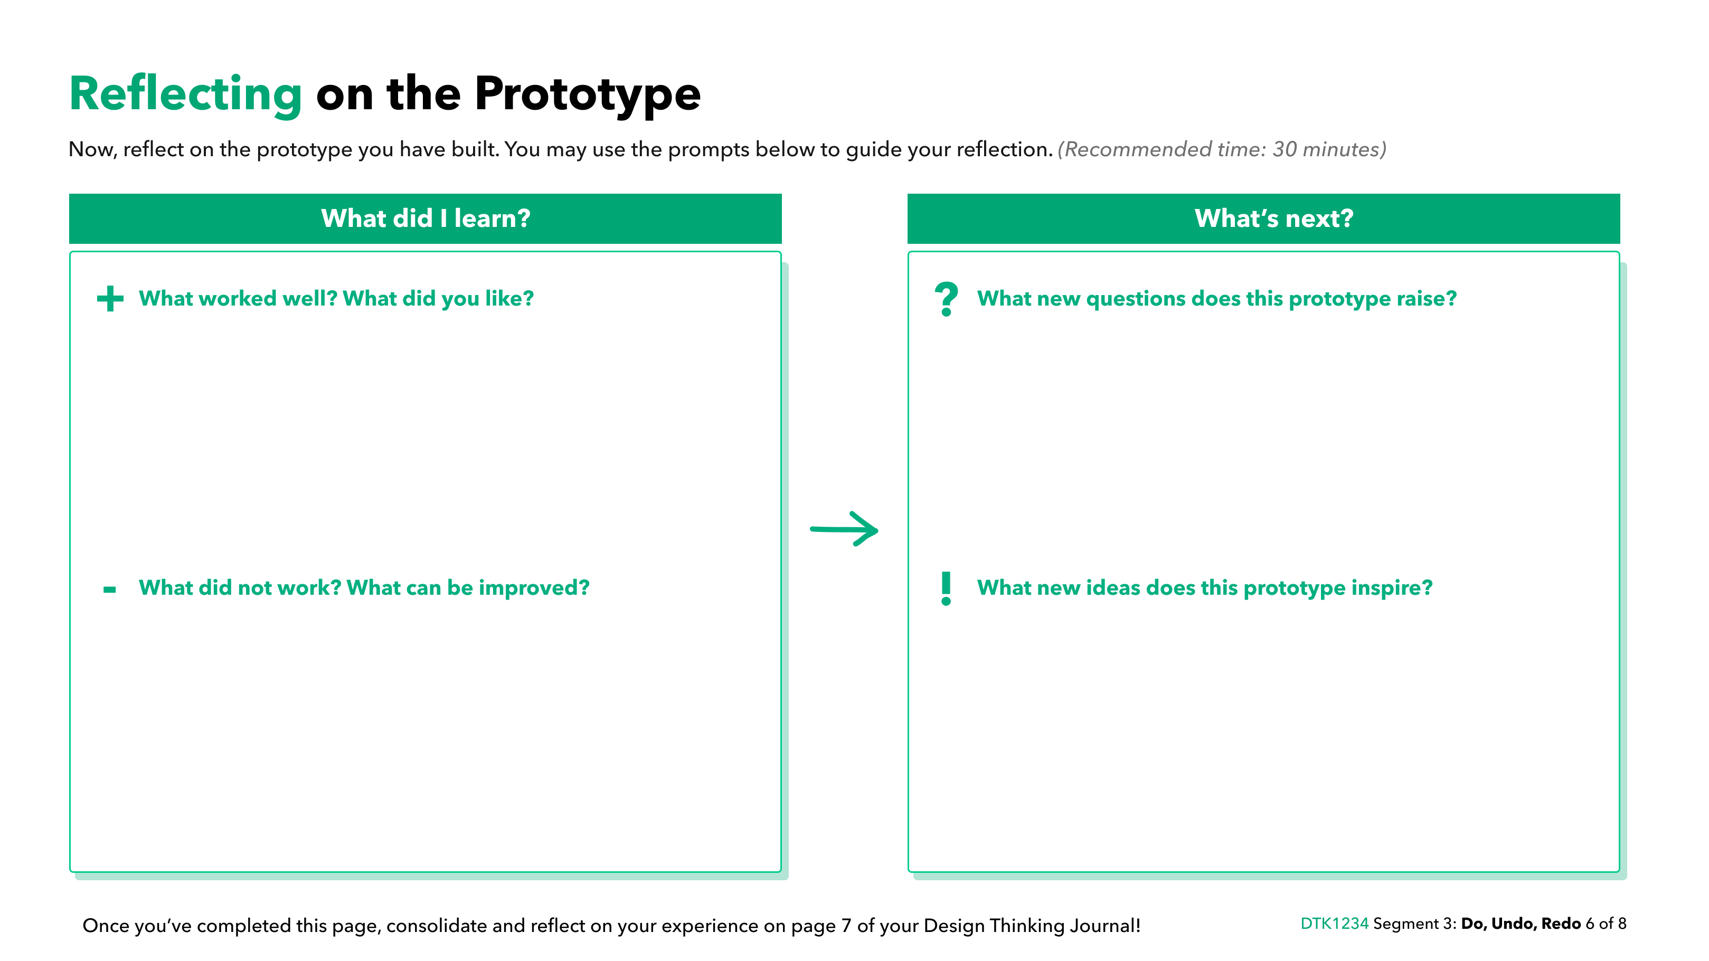
[Type here]
[Type here]
[Type here]
[Type here]
Notes:
Credit: d.school experiment mix tape. https://dschool.stanford.edu/resources/chart-a-new-course-put-design-thinking-to-work

Slide 7
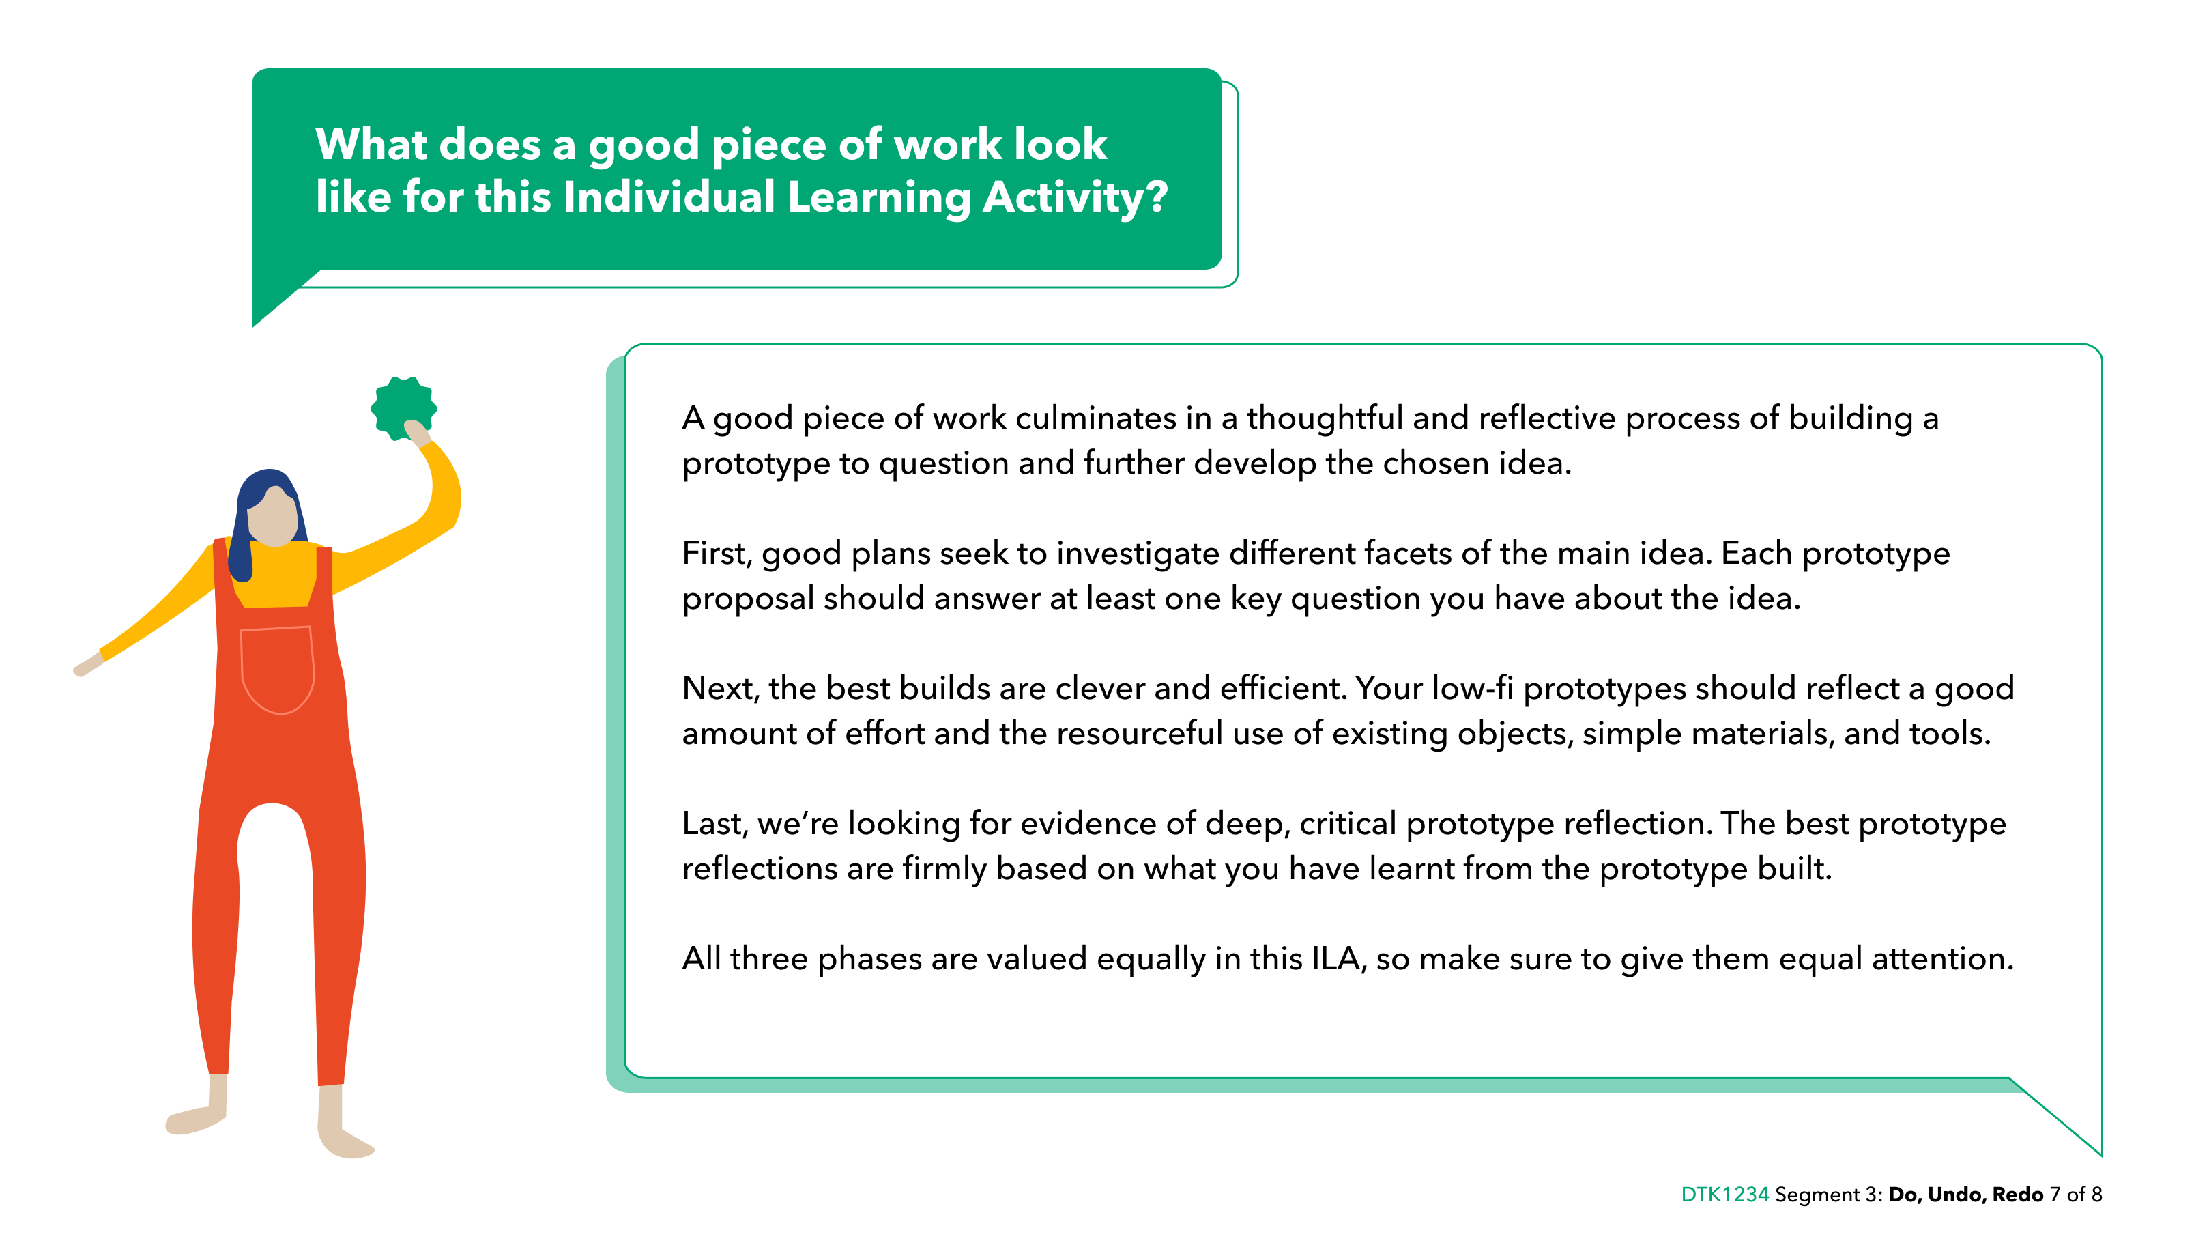

Slide 8
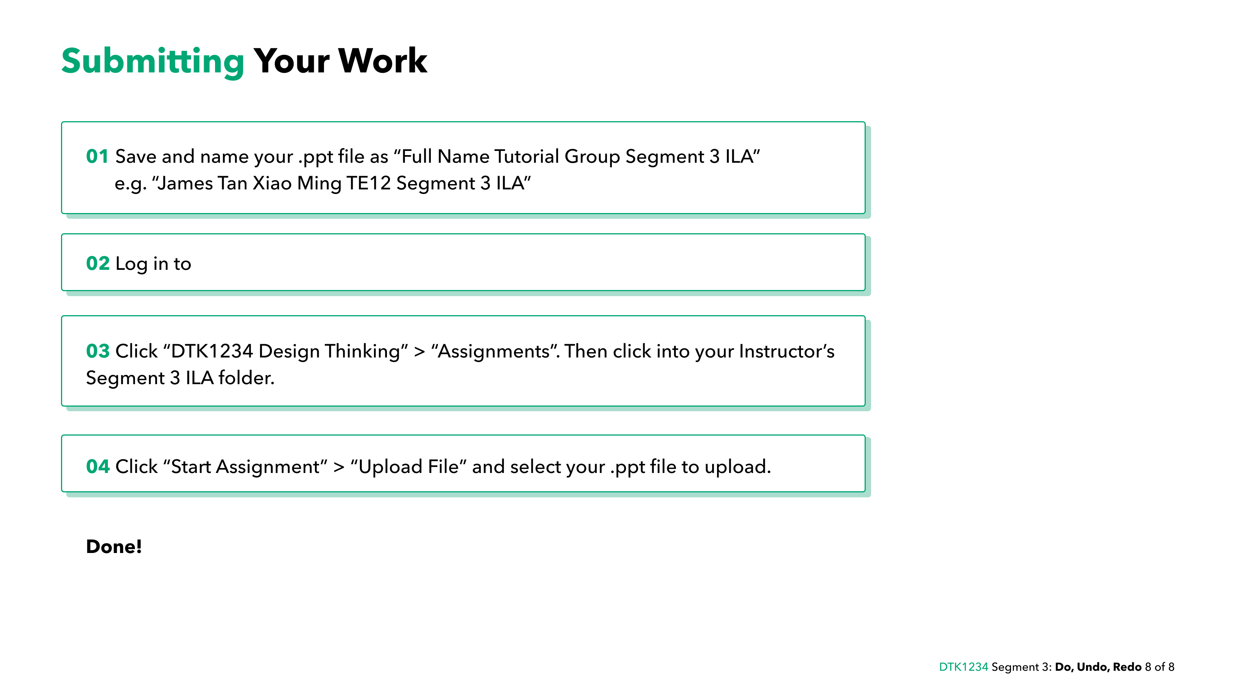
https://canvas.nus.edu.sg/
Notes:
https://canvas.nus.edu.sg/

